Slide 1

THE MEADOWS CENTER FOR WATER AND THE ENVIRONMENT
No natural resource is more important to our future than Water. Water is what we do.
RESEARCH | STEWARDSHIP | SERVICE | EDUCATION

Slide 2
Dr. Andrew Sansom
Executive Director
Meredith Miller
Senior Program Coordinator
MBMiller@txstate.edu
512-245-6697
No natural resource is more important to our future than Water. Water is what we do.
RESEARCH | STEWARDSHIP | SERVICE | EDUCATION | SERVICE

Slide 3

The Meadows Center for Water and the Environment
201 San Marcos Springs Drive | San Marcos, TX. 78666
Ph. 512.249.9200 | meadowscenter@txstate.edu

Slide 4
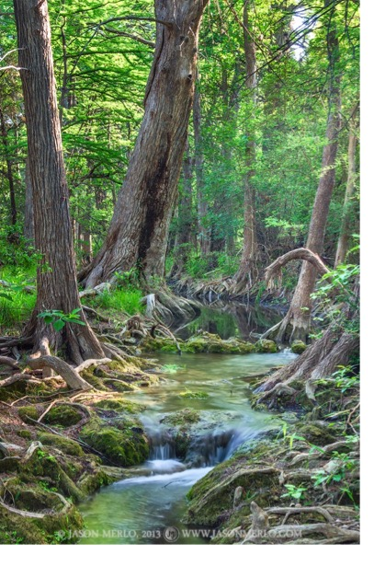
Topics to Cover
Primer on Watershed Plan
Woodreek Dam
Bacterial Source Tracking Efforts
Water Quality Monitoring

Slide 5
Cypress Creek Watershed Protection Plan
Background – Listed in 2000 for inadequate DO. That year, and in subsequent years, the creek stopped flowing.
Stakeholder partnership formed, led by Local Stakeholders, City of Wimberley, City of Woodcreek, Hays County, Wimberley Valley Watershed Association.
TCEQ 319 funding to develop a science-based, stakeholder driven Watershed Protection Plan
The Meadows Center for Water and the Environment
201 San Marcos Springs Drive | San Marcos, TX. 78666
Ph. 512.249.9200 | meadowscenter@txstate.edu

Slide 6
Parameters of Concern or Exceeding Target Levels
 | Primary Causes
Nitrogen | Residential and Commercial fertilizer applications, OSSFs, animal waste, overland flow/impervious cover, atmospheric deposition and low flows.
Total Suspended Solids | Anthropogenic activities, disturbed land cover, impervious cover and natural processes on undeveloped land, low flows.
E. coli | OSSFs, pets, wildlife, low flows.
Dissolved Oxygen | Low base flows limit aeration of water downstream of ground/source waters.
Oil and Grease | Residential wastewater, transportation corridors, improper waste management.
Impervious Cover increases | Increased urbanization.
Preferred Base Flows | Increased water use and well pumpage.

Slide 7
Cypress Creek Watershed Goals
Activities to prevent pollution, protect flow
Preserve water quality through local permitting, ordinances
Improve tools for decision makers to calculate effects of land use changes on water quality
Site-specific LID/Green Infrastructure demonstration sites
Outreach and education efforts
Monitoring and modeling water quality changes
The Meadows Center for Water and the Environment
201 San Marcos Springs Drive | San Marcos, TX. 78666
Ph. 512.249.9200 | meadowscenter@txstate.edu

Slide 8
Cypress Creek Watershed Plan Components
Structural BMPs
Non-structural BMPs (incentives, regulations, education)
Source water protection
Land management, conservation
Research
Monitoring
The Meadows Center for Water and the Environment
201 San Marcos Springs Drive | San Marcos, TX. 78666
Ph. 512.249.9200 | meadowscenter@txstate.edu

Slide 9
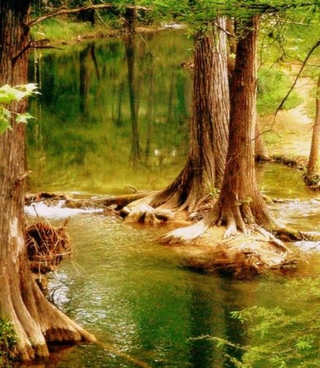
Cypress Creek Watershed Protection Plan
Accepted by TCEQ and EPA
Implementation grant funded
  State/Federal Contribution $804,843
  Partner and stakeholder Contributions $529,362
  Total Cost: $1,334,205
Timeline: Sept 2016– Aug 2019
The Meadows Center for Water and the Environment
201 San Marcos Springs Drive | San Marcos, TX. 78666
Ph. 512.249.9200 | meadowscenter@txstate.edu

Slide 10
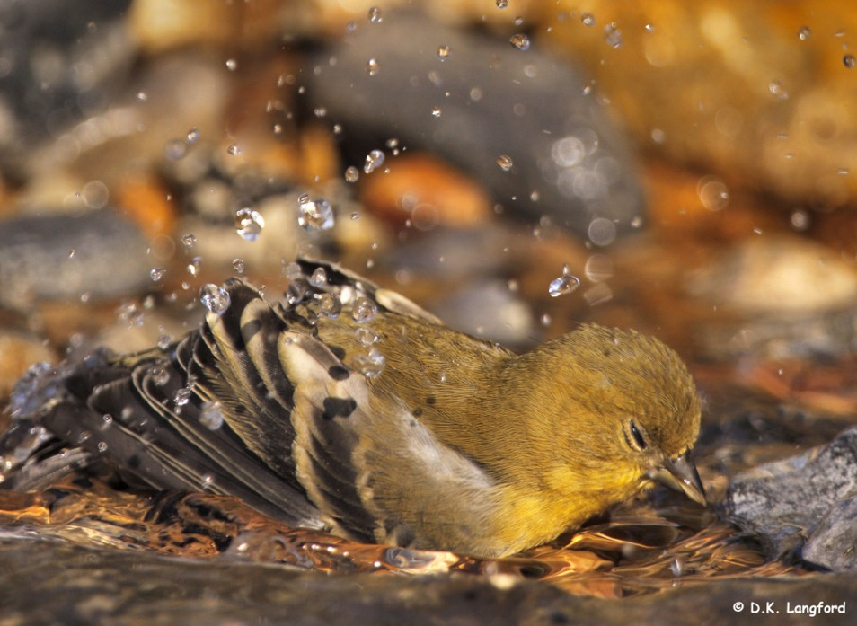

Slide 11
Woodcreek Dam –July 6
HTGCD, Meadows Center & Aqua Texas staff site visit.
Collapse feature 5 ft upstream from the dam
3 iron sewage pipes underneath dam, operated by Aqua Texas (1 decommissioned)
Capful of dye poured upstream of the feature. After 30 seconds dye emerged into pool on downstream side of the dam in 2 locations
Likely result of structural damage (undermining of the dam) allowing water from to flow underneath dam rather than pooling behind it
Contacted County, Woodcreek, TCEQ, TPWD, GBRA, HTGCD, Aqua TX, WVWA, POA and others
The Meadows Center for Water and the Environment
201 San Marcos Springs Drive | San Marcos, TX. 78666
Ph. 512.249.9200 | meadowscenter@txstate.edu

Slide 12
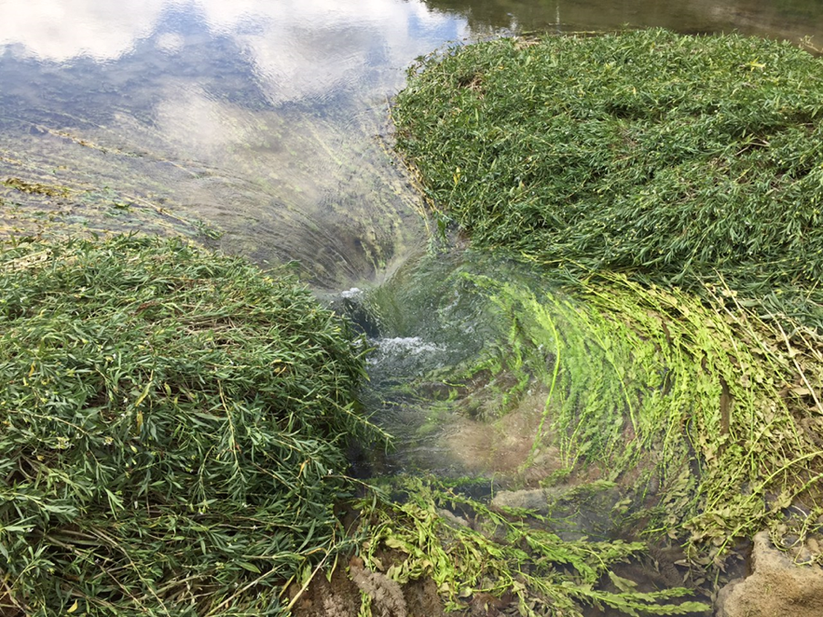

Slide 13
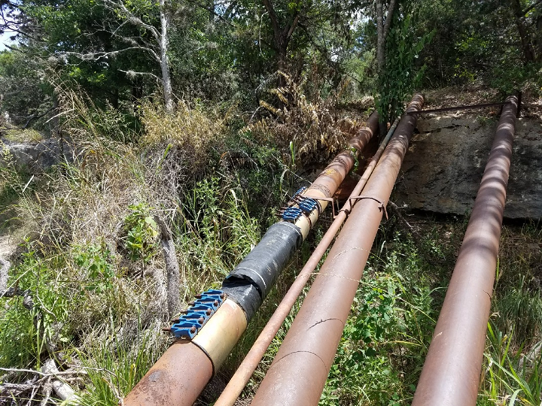

Slide 14
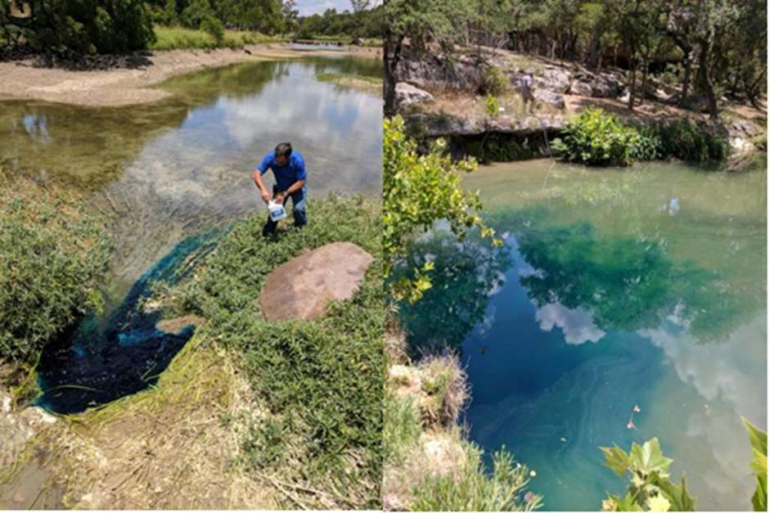

Slide 15
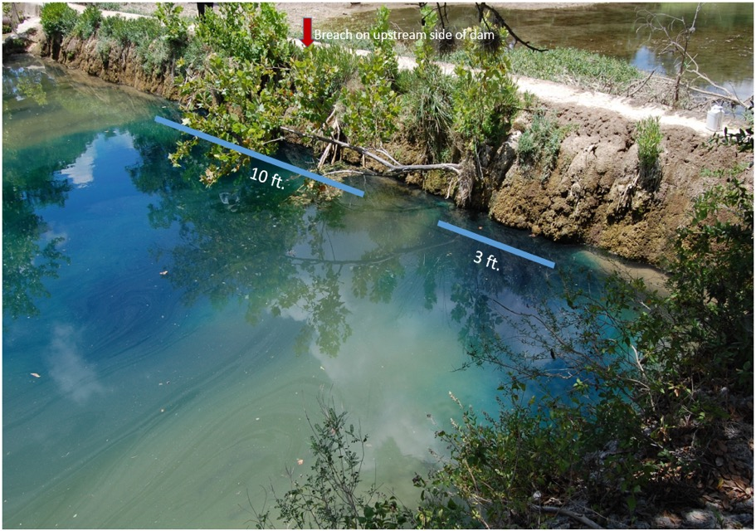

Slide 16
Woodcreek Dam - July 17th
County acting as lead, Meadows Center providing support and compiling information
County working with dam owner
Very limited availability of records for dam
2 sampling events – bacteria well below standard at all sites
TCEQ, GBRA, HTGCD – no jurisdiction, TPWD prepared to assist if a spill occurs
The Meadows Center for Water and the Environment
201 San Marcos Springs Drive | San Marcos, TX. 78666
Ph. 512.249.9200 | meadowscenter@txstate.edu

Slide 17
Woodcreek Dam - July 17th
From TPWD: “Most of the Cypress Creek channel between Jacob’s Well and the confluence with the Blanco River is state-owned, and the creek is considered navigable, the state has an interest in activity involving the channel. Typically, a sand & gravel permit from TPWD and an easement from the General Land Office would be required for disturbance within the channel or for disturbing or removing sedimentary material within the channel, including for repair or placement of structures within the channel.”
The Meadows Center for Water and the Environment
201 San Marcos Springs Drive | San Marcos, TX. 78666
Ph. 512.249.9200 | meadowscenter@txstate.edu

Slide 18
Woodcreek Dam - July 23rd-25th
Report of small hole downstream side of dam and individuals dumping additional gravel, concrete etc in upstream collapse
Samples collected upstream – low levels of bacteria consistent with prior sampling and expected/historic levels
Sample of water being discharged out of a small hole on the downstream side of the dam – very high results (too numerous to count ~ 2000 CFU/mL
Requested additional input from TCEQ, advised community not to swim until more comprehensive testing could be done
Reported to County, County sampled at multiple downstream sites, Aqua reported no signs of pipe leakage to County
The Meadows Center for Water and the Environment
201 San Marcos Springs Drive | San Marcos, TX. 78666
Ph. 512.249.9200 | meadowscenter@txstate.edu

Slide 19
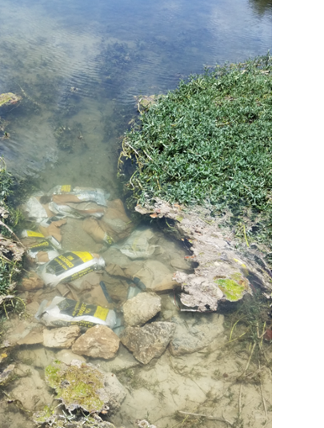
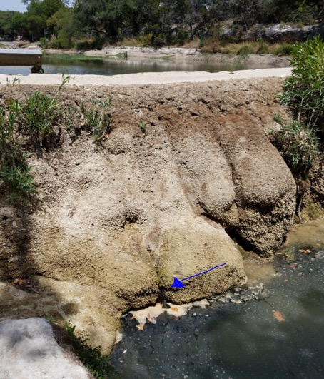

Slide 20
Woodcreek Dam - Additional Information Reported
July 6 - Owner of the Lodge put metal grating, rocks and 3 bags of concrete on hole.
Next couple of days - Water drainage slowed and brown scum is caught on rocks. Creek level rises slightly and water on downstream side of dam becomes crystal clear.
Subsequently, water erodes around rocks, enlarges hole, washes brown scum through and water below dam becomes scummy again.
July 22 - another neighbor adds 3 more bags of concrete and rocks to the hole.
July 24 - water is barely draining, brown scum is being caught, creek level has visibly risen and water downstream of dam is crystal clear. However, a small new hole has appeared on the downstream side of the dam about 20' to the west of big hole with an audible bubble and brown scum.
The Meadows Center for Water and the Environment
201 San Marcos Springs Drive | San Marcos, TX. 78666
Ph. 512.249.9200 | meadowscenter@txstate.edu

Slide 21
Woodcreek Dam – August 2nd
All County samples from previous week are well below the standard
Likely that bacteria is site specific, not affecting downstream conditions
Will continue regular sampling/monitoring
The Meadows Center for Water and the Environment
201 San Marcos Springs Drive | San Marcos, TX. 78666
Ph. 512.249.9200 | meadowscenter@txstate.edu

Slide 22
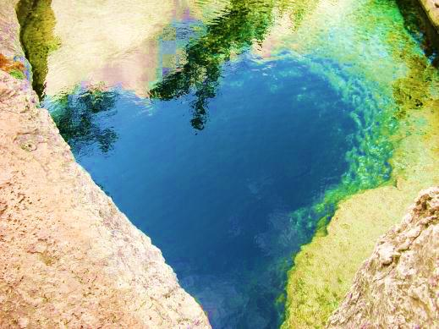

Slide 23

Bacterial Source Tracking – March 2017
Submitted proposal to Texas Commission on Environmental Quality in 2015 & Texas Soil and Water Conservation board in 2016 to do BST – not funded
Coordinating with Plum Creek WPP, Texas A&M, GBRA to combine BST efforts
  Secured funding and matched funding from Hays County
  Quality assurance plans for data collection and analyses
  Professional secondary analyses
The Meadows Center for Water and the Environment
201 San Marcos Springs Drive | San Marcos, TX. 78666
Ph. 512.249.9200 | meadowscenter@txstate.edu

Slide 24
Current City Bacterial Source Tracking
City approved Service Agreement with Zara (Feb 2017)
Task 1: collect at least two samples of guano to facilitate TWRI adding bats to the isolate library
Task 2: Two collection events, approximately one mo. apart
  Samples from 3 locations along Creek identified by City
  Send samples to A&M
~ $6000 budget ← not including lab costs
The Meadows Center for Water and the Environment
201 San Marcos Springs Drive | San Marcos, TX. 78666
Ph. 512.249.9200 | meadowscenter@txstate.edu

Slide 25
Current City Bacterial Source Tracking
Limitations include
Data/analyses for determining sites
Limited number of sampling locations and events
Would be helpful to have a more robust sampling regime
Quality assured data and professional analyses to determine sampling locations
Number of sampling events, sites
Number of bacteria isolates analyzed
Type of data collected (birds, bats, pets, humans and other wildlife)
The Meadows Center for Water and the Environment
201 San Marcos Springs Drive | San Marcos, TX. 78666
Ph. 512.249.9200 | meadowscenter@txstate.edu

Slide 26
Potential to Add Capacity
Coordinate with the City to collect site selection data and analyze existing data
Coordinate with Zara
Additional sampling events
Additional sampling locations
Conduct routine, ambient monitoring
Analyze for other species
Coordinate with City
Analyses and reporting
Incorporate results into efforts funded by Plan
Funds for additional monitoring
The Meadows Center for Water and the Environment
201 San Marcos Springs Drive | San Marcos, TX. 78666
Ph. 512.249.9200 | meadowscenter@txstate.edu

Slide 27
Bacterial Source Tracking –
Spring/Summer 2017
City efforts on hold
May – directions to proceed with our portion of collaborative effort
Redesigned study parameters, schedule and quality assurance/control plan
Contracted with Plum Creek Watershed Plan Coordinator for sampling and oversight
Agreement with Texas A&M for DNA analyses
Coordination with TX A&M for additional bat markers
Sampling in August, September and October
The Meadows Center for Water and the Environment
201 San Marcos Springs Drive | San Marcos, TX. 78666
Ph. 512.249.9200 | meadowscenter@txstate.edu

Slide 28
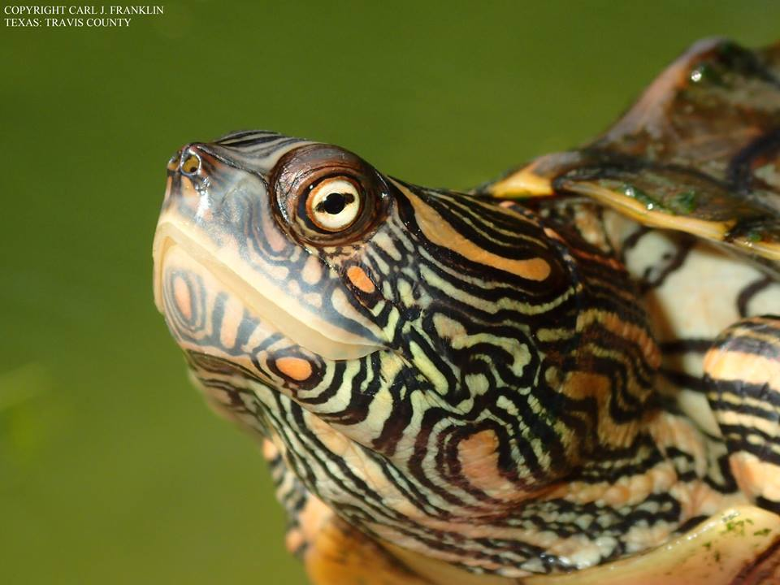

Slide 29
History of the Clean Water Act
Quick Links
The Federal Water Pollution Control Act of 1948 was the first major U.S. law to address water pollution. Growing public awareness and concern for managing water pollution led to sweeping amendments in 1972 and what is now commonly know as the Clean Water Act. (CWA).
The 1972 amendments:
Established the basic structure for regulating pollutant discharges into the waters of the United States.
Gave EPA the authority to implement pollution control programs such as setting wastewater standards for industry.
Maintained existing requirements to set water quality standards for all contaminants in surface waters.
Made it unlawful for any person to discharge any pollutant from a point source into navigable waters, unless a permit was obtained under its provisions.
Funded the construction of sewage treatment plants under the construction grants program.
Recognized the need for planning to address the critical problems posed by nonpoint source pollution.

Slide 30
Ongoing/Historical
Water Quality Monitoring
Texas Clean Rivers Program – quality assured
Watershed Plan (previous) - quality assured
Watershed Plan (new) - quality assured
Citizens’ Wimberley Water Advisory Group – limited quality assurance
City staff monitoring
Texas Stream Team - quality assured
The Meadows Center for Water and the Environment
201 San Marcos Springs Drive | San Marcos, TX. 78666
Ph. 512.249.9200 | meadowscenter@txstate.edu

Slide 31
Texas Clean Rivers Program
Mission: Working together for clean water and science-based decisions.
Provide quality-assured data to the TCEQ for use in decision-making and assessment of compliance with Clean Water Act water quality standards
Identify and evaluate water quality issues
Promote cooperative watershed planning
Recommend management strategies
Inform and engage stakeholders
Maintain efficient use of public funds
https://www.tceq.texas.gov/waterquality/clean-rivers
The Meadows Center for Water and the Environment
201 San Marcos Springs Drive | San Marcos, TX. 78666
Ph. 512.249.9200 | meadowscenter@txstate.edu

Slide 32
GBRA - Clean Rivers Program
GBRA partners with TCEQ to administer the Clean Rivers Program (CRP) for the Guadalupe River and Lavaca-Guadalupe Coastal Basins.
The Wimberley Valley Watershed Association (WVWA) began funding the program with help from the City of Wimberley in 2003. The program contributes monitoring data collected under the Guadalupe Basin CRP quality assurance project plan (QAPP) from the Blanco River and Cypress Creek watersheds.
TCEQ and USEPA quality assure data and program efforts.
Meadows Center staff (trained by GBRA and listed in the QAPP collects data. GBRA laboratory analyzes data/samples.
TCEQ uses the data for decision making purposes, water quality impairment listings
Data has been collected on many sites since 1998
https://www.tceq.texas.gov/waterquality/clean-rivers
The Meadows Center for Water and the Environment
201 San Marcos Springs Drive | San Marcos, TX. 78666
Ph. 512.249.9200 | meadowscenter@txstate.edu

Slide 33
Clean Rivers Program
Why do we collect this data?
Clean water is valuable to the community
  Economic, intrinsic, way of life
Clean Water Act compliance
  Cypress Creek listing in 2000
  Historical baselines and information

Slide 34
Clean Rivers Program
Cypress Creek at RR12 Bridge Downtown site collected by GBRA
4 additional sites on Cypress collected by WVWA/Meadows
5 sites on Blanco collected by WVWA/Meadows
Also 24 hour dissolved oxygen testing at 2 sites (Blue Hole and Cypress/Blanco confluence) 2 x year
The Meadows Center for Water and the Environment
201 San Marcos Springs Drive | San Marcos, TX. 78666
Ph. 512.249.9200 | meadowscenter@txstate.edu

Slide 35
Clean Rivers Program
Sites previously monitored monthly, now quarterly for:
Temperature
Conductivity
Dissolved Oxygen
pH Nitrate/Nitrite-Nitrogen
Total Phosphorus
Total Suspended Solids
Ammonia
E. coli (#/100 mL)
Flow
The Meadows Center for Water and the Environment
201 San Marcos Springs Drive | San Marcos, TX. 78666
Ph. 512.249.9200 | meadowscenter@txstate.edu

Slide 36
Clean Rivers Program
“The monitoring activities are conducted under an approved Quality Assurance Project Plan (QAPP) in order to provide the level of consistency and scientific validity needed for environmental monitoring and decision. The QAPP is critical for documenting how GBRA and UGRA plans, implements and assesses the water quality of the basin. It includes sections on the project organization, background, quality objectives, training requirements, record-keeping, methodologies and equipment maintenance.”
The Meadows Center for Water and the Environment
201 San Marcos Springs Drive | San Marcos, TX. 78666
Ph. 512.249.9200 | meadowscenter@txstate.edu

Slide 39


Slide 42


Slide 43


Slide 44
Blanco River

Slide 45
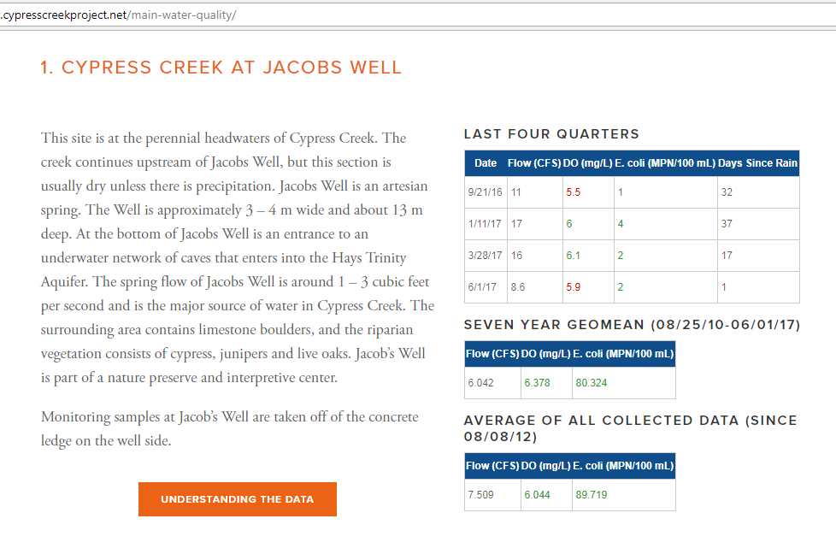
Another Way to Look at the Data

Slide 46
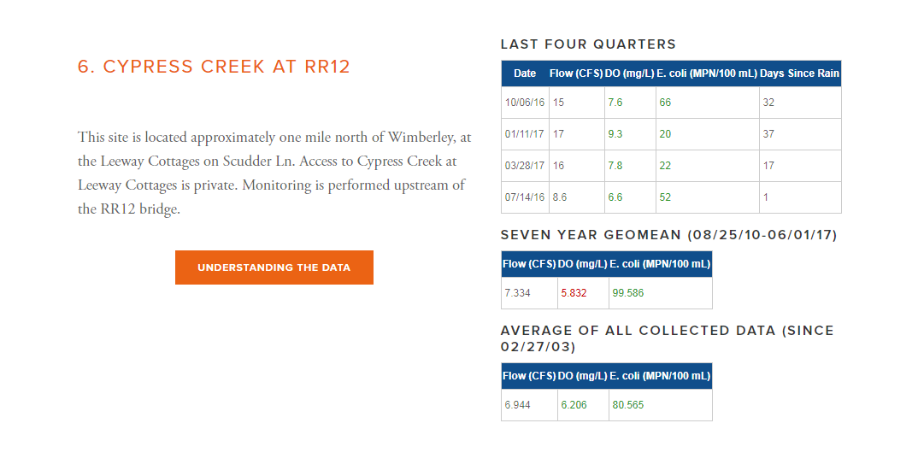
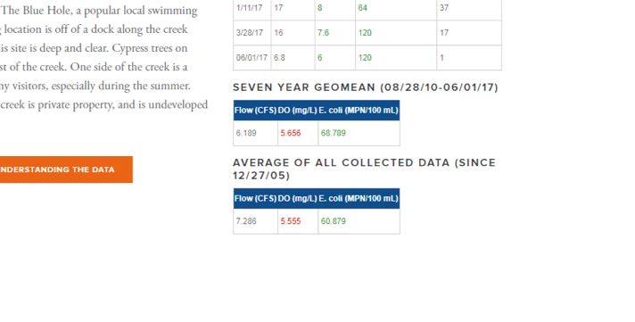

Slide 47
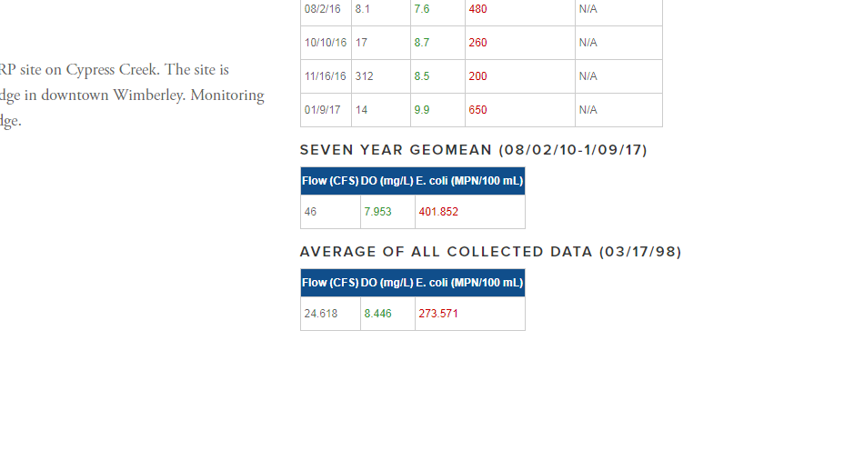

Slide 48
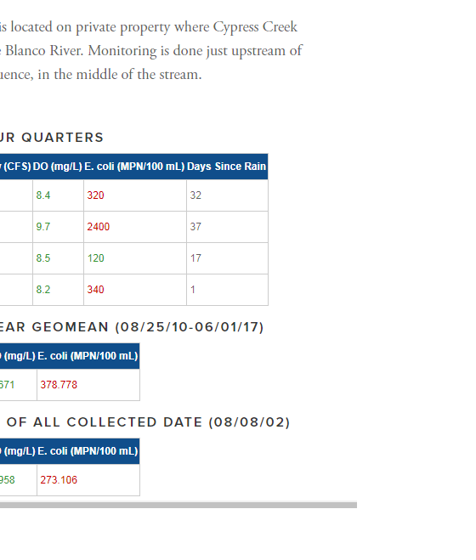

Slide 49
Trends in Bacteria –
Downtown and Blanco Confluence
E. Coli values downtown are consistently higher than those upstream
Data trends show a steady increase in bacteria downtown and at the confluence with the Blanco
Bacteria returns to lower levels downstream of the confluence and are low above Cypress Creek

Slide 50
For Thought - Drivers of Water Quality
Declining groundwater levels – lower flows result in worsening water quality
Impacts of drought – lower flows, increased temperatures negatively affect dissolved oxygen and bacteria
Growth, development – increased impervious cover/increased stormwater flows; nonpoint source pollution from homes, cars, businesses; changes in wildlife habitat/patterns; aging infrastructure
The Meadows Center for Water and the Environment
201 San Marcos Springs Drive | San Marcos, TX. 78666
Ph. 512.249.9200 | meadowscenter@txstate.edu

Slide 51
Clean Rivers Program
What expanded research is needed.
Why investing CRP and the WPP is important for the health and economy of Wimberley.
The Meadows Center for Water and the Environment
201 San Marcos Springs Drive | San Marcos, TX. 78666
Ph. 512.249.9200 | meadowscenter@txstate.edu

Slide 52
What Can We Do?
The future of your quality of life and economic prosperity are tied to maintaining excellent water quantity and quality. How can we work together?
Citizens involved in local efforts – Texas Stream Team, Riparian Restoration Support Group, WPP, WVWA, Friends of Blue Hole
Learn about preventing nonpoint source pollution and water conservation
The Meadows Center for Water and the Environment
201 San Marcos Springs Drive | San Marcos, TX. 78666
Ph. 512.249.9200 | meadowscenter@txstate.edu

Slide 53

THANK YOU
  Explore Spring Lake | Join Us | Partner Up | Sponsor a Project | Put Us to Work
The Meadows Center for Water and the Environment
201 San Marcos Springs Drive | San Marcos, TX. 78666
Ph. 512.249.9200 | meadowscenter@txstate.edu
EXPLORE SPRING LAKE.ORG

